Slide 1



CHARITABLE DATA ANALYTICS BY OLUSEYE OYENIRAN

Slide 2


DATA COLLECTION & PREPARATION
37,792 ROWS OF DONORS’S RAW DATA WERE EXAMINED AND PREPARED FOR ANALYSIS
50 COLUMNS OF DONORS’S RAW DATA WERE EXAMINED AND PREPARED FOR ANALYSIS

Slide 3

DATA COLLECTION & PREPARATION
SOME COLUMNS WITH MISSING VALUES
WERE REPLACED WITH SUMMARY STATISTICS(MEDIAN)
E.G DONOR_AGE,INCOME_GROUP,
WEALTH_RATING,MONTHS_SINCE_LAST_PROM_PREP

Slide 4
MODEL BUILDING
It is a classification problem
Our label variables from our donor data is represented by
0 and 1
O has not donated in the past
1 has donated in the past

Slide 5
Model building
Our aim is to build a classification model using a logistic regression
The model is to predict who is liable to donate for the charity organization based on features found in the past donation data.

Slide 6
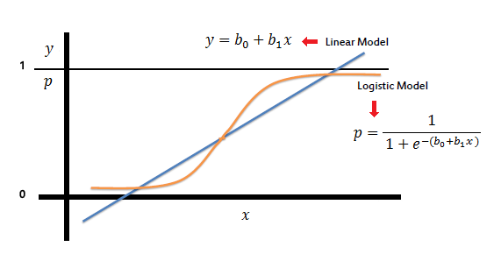
Logistic Regression Model

Slide 7

PREDICTED_ DONOR
Our model predicted
31 donor
out of 2148 prospective
donor _ data.
These prospects should be
the focus of the charity
organization

Slide 8
PREDICTED DONOR

Slide 9

RECOMMENDATION
We therefore recommend
that the charity
organization should focus their
next campaign
on those 31 prospects in order
to minimize cost associated
with soliciting for donations.

Slide 10
END OF PRESENTATION

